Slide 1
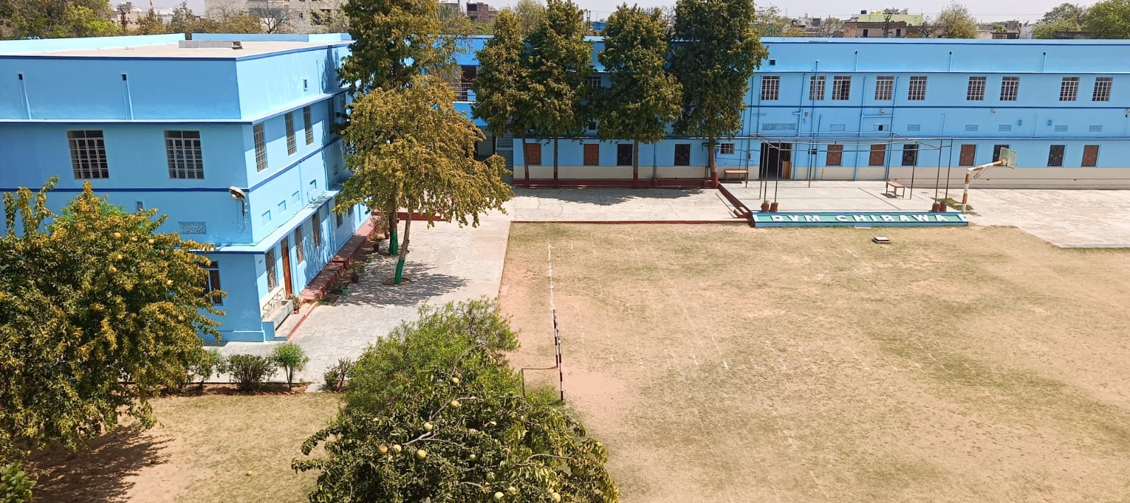







DALMIA VIDYA MANDIR, CHIRAWA
ACHIEVEMENT
2025

Slide 2




ACADEMIC
EXCELLENCE
“Success is not Final, Failure is not Fatal: It is the Courage to Continue that Counts.”
@
DVM CHIRAWA

Slide 3

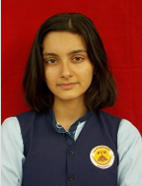

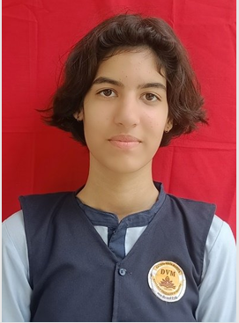
ACADEMIC EXCELLENCE
Class-X (2024-25)
CONGRATULATIONS
Akshra
Ishita Choudhary

Slide 4
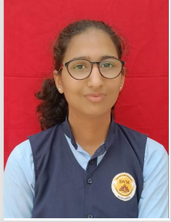
ACADEMIC EXCELLENCE
Class-XII-Science (2024-25)
CONGRATULATIONS
Nishita

Slide 5
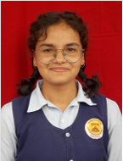
ACADEMIC EXCELLENCE
Class-XII-Commerce(2024-25)
CONGRATULATIONS
Komal
Jangir

Slide 6
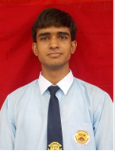
ACADEMIC EXCELLENCE
Class-XII-Humanities (2024-25)
CONGRATULATIONS
Keshav
Sharma

Slide 7




SPORTS ACHIEVEMENT
CBSE/RBSE/West Zone/National/State

Slide 8
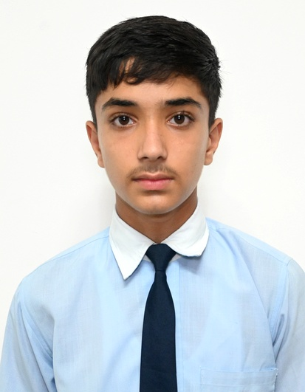
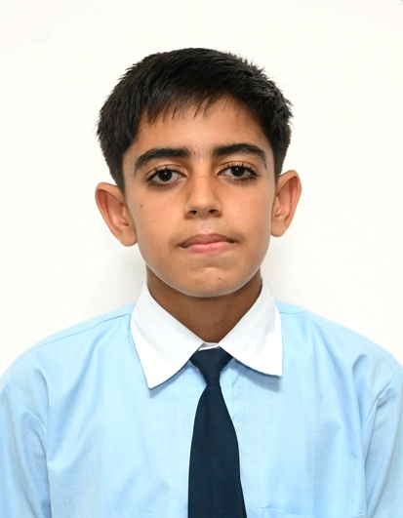
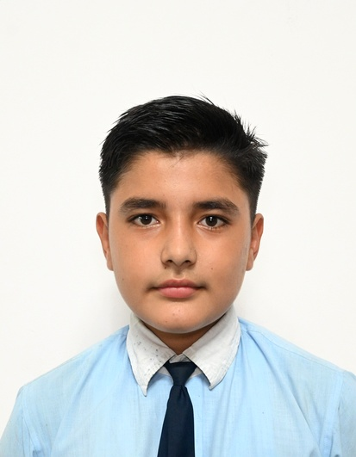
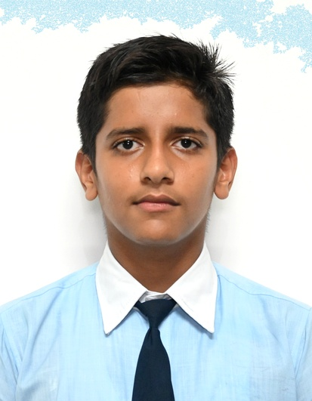
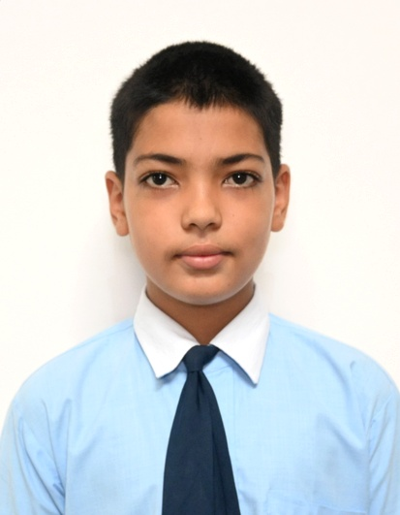
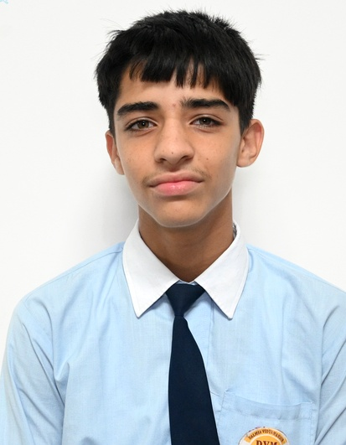
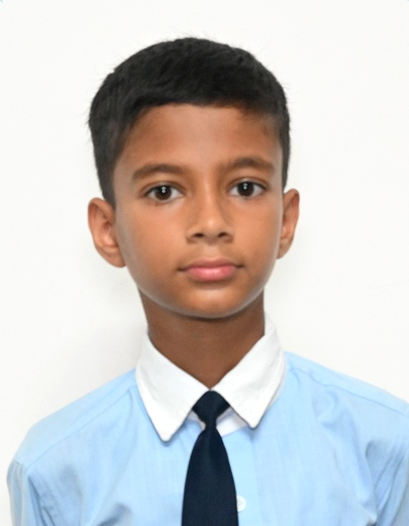
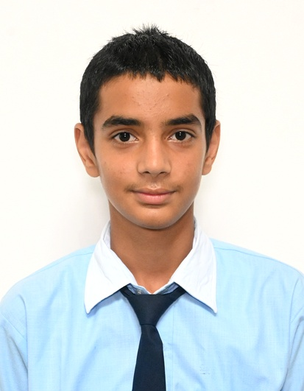
FOOTBALL
CBSE NATIONAL/SGFI STATE
UNDER-14 BOYS (2025-26)
CONGRATULATIONS
DEEPANSHU
POONIA
DAKSH
CHOUDHARY
KEYAAN
POONIA
YATHARTH
CHOUDHARY
MUDIT
RAO
TTANMAY RISHU
KOCKHA
SAKSHAM
NUNIA
AYUSH
SGFI DISTRICT GOLD MEDAL & STATE SILVER MEDAL
CBSE CLUSTER
GOLD MEDAL

Slide 9
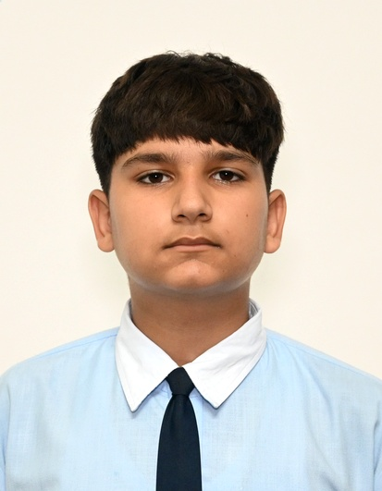
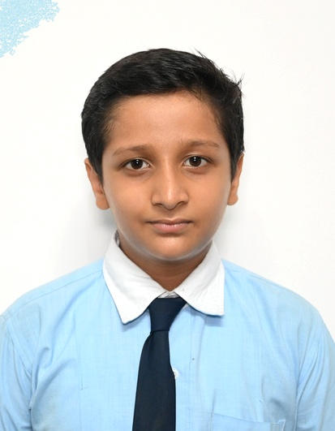
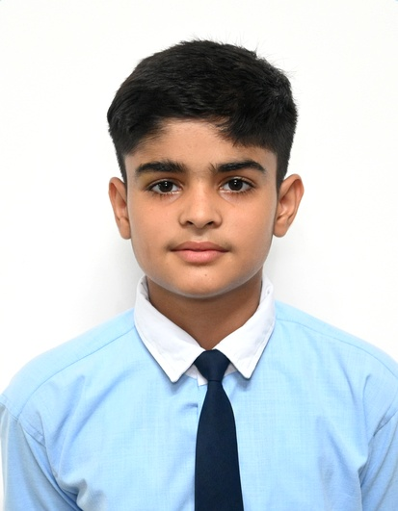
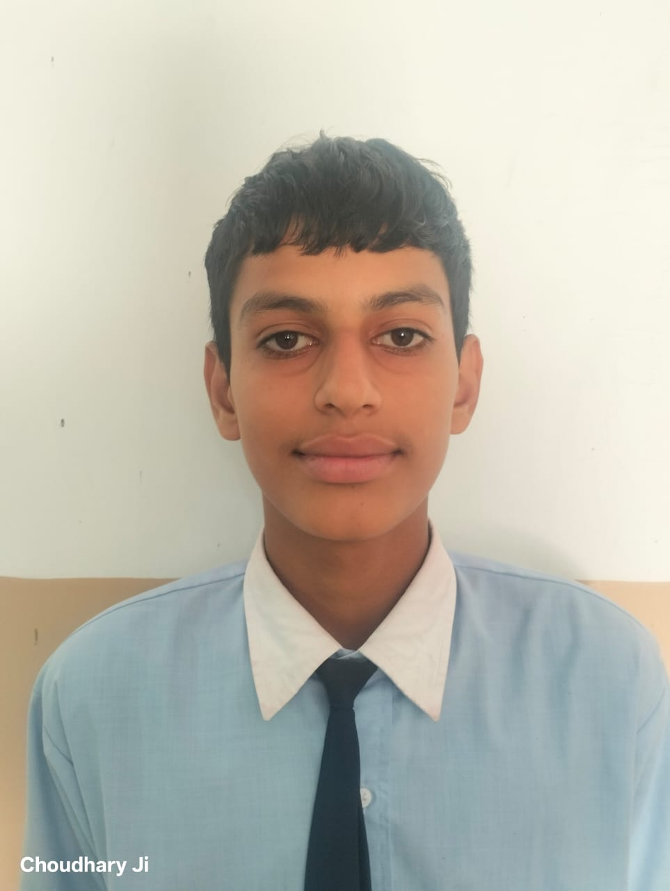
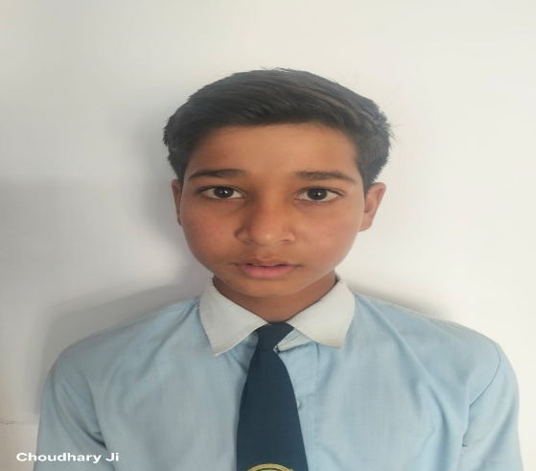
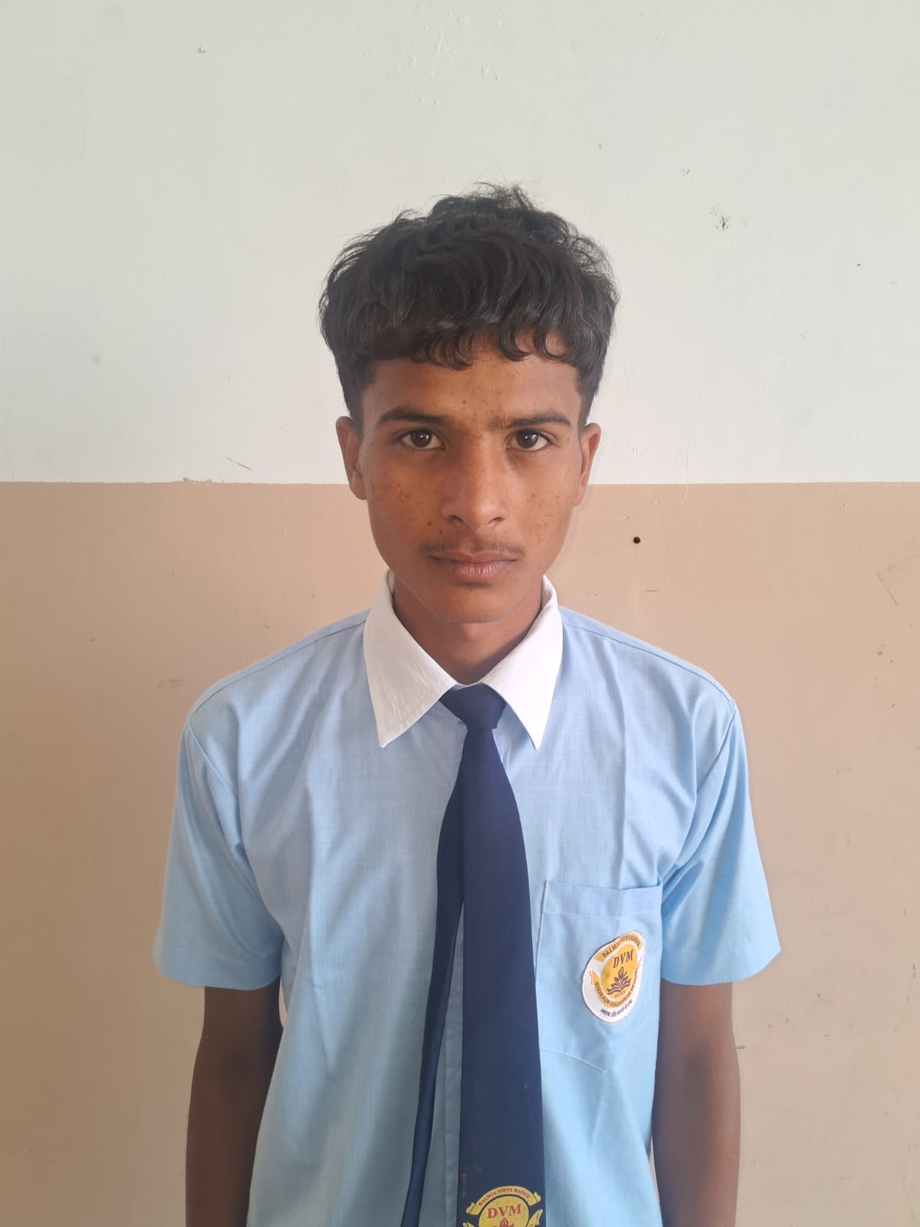
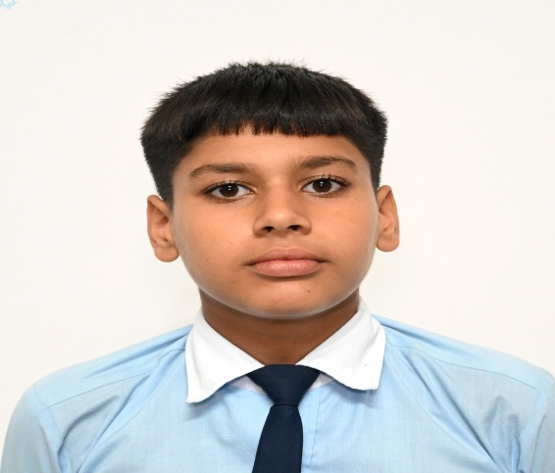
FOOTBALL
CBSE NATIONAL/SGFI STATE
UNDER-14 BOYS (2025-26)
CONGRATULATIONS
DAKSH
OLA
TAVISH
MISHRA
NIHAR
RAO
NIKESH
BORANIA
NAKSH
NAYAK
NITESH
KUMAR
MAHESH
CBSE CLUSTER
GOLD MEDAL
SGFI DISTRICT GOLD MEDAL
& SILVER MEDAL

Slide 10
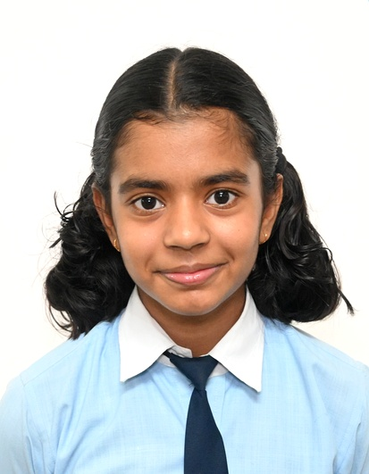
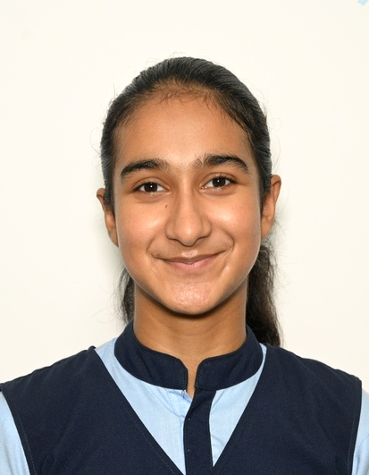
BADMINTON
SGFI STATE
UNDER-14 & 19 GIRLS (2025-26)
CONGRATULATIONS
SGFI DISTRICT SILVER MEDAL
BHUMI
VERMA
DEEPAL

Slide 11
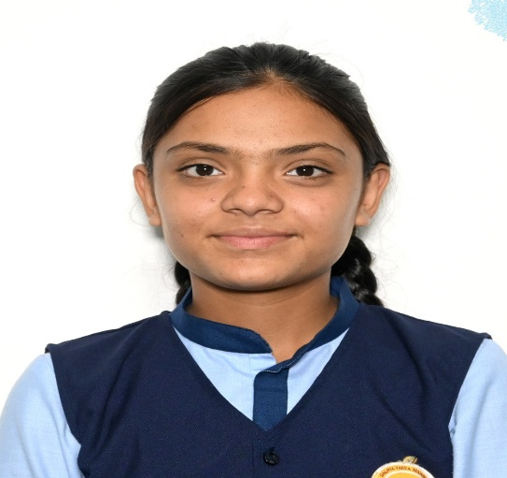
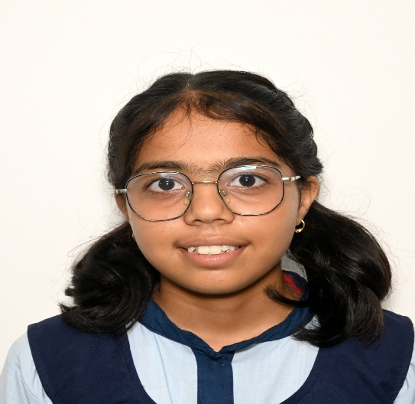
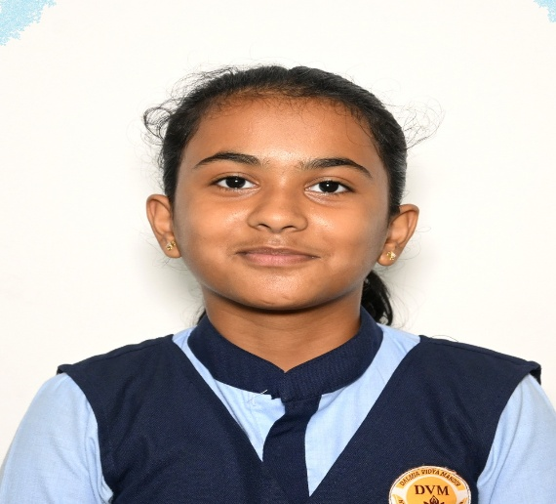
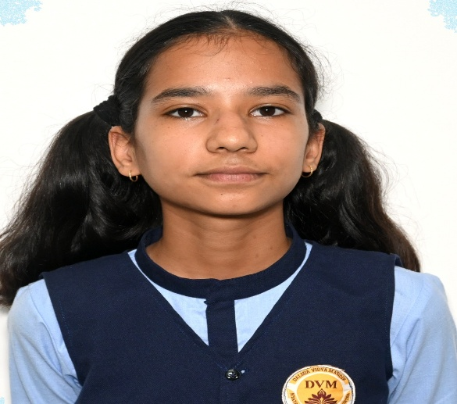
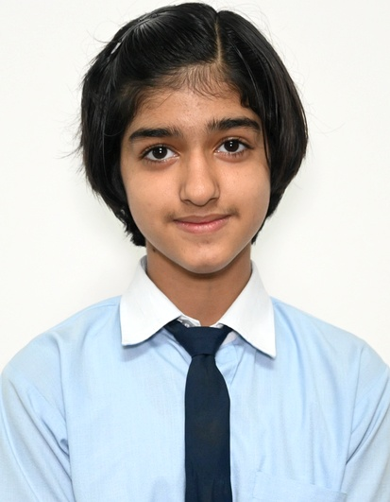
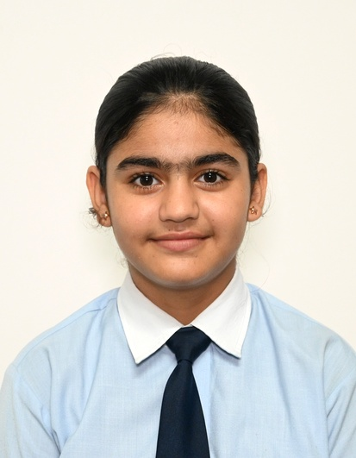
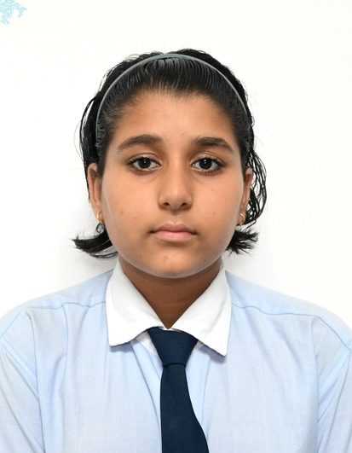
HOCKEY
CBSE WEST ZONE
UNDER-14 & 17 GIRLS (2025-26)
CONGRATULATIONS
DIMPLE
KHUSHI
AARVI JANGU
MANVI
NEHRA
RIYA
KULHAR
UNNATI
NEHA
SGFI DISTRICT GOLD & SILVER MEDAL &
CBSE WEST ZONE
SILVER MEDAL

Slide 12
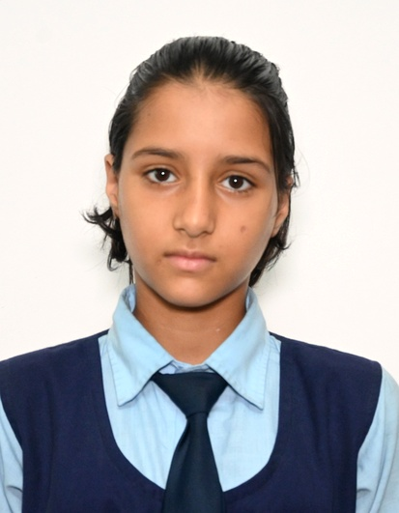
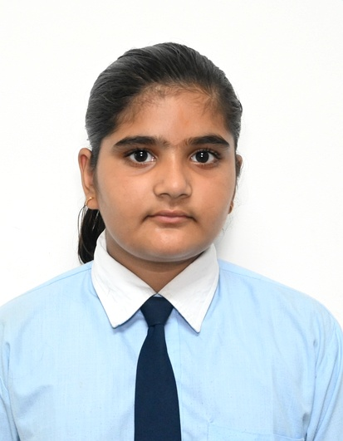
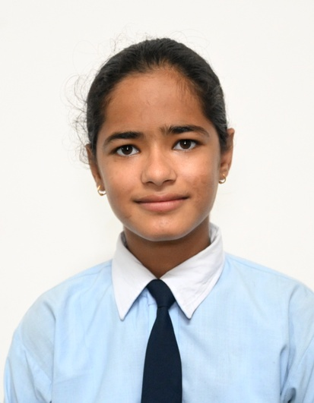
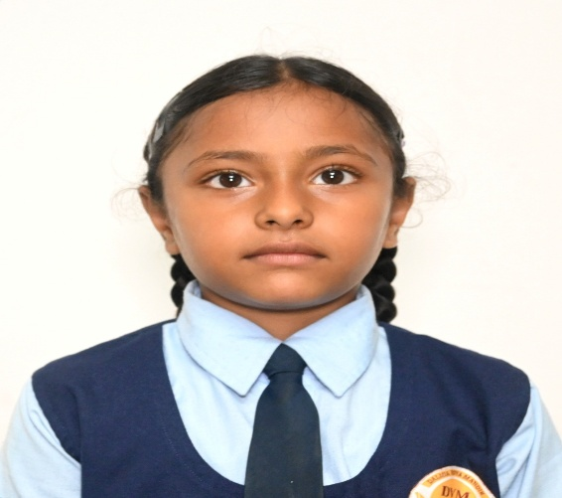
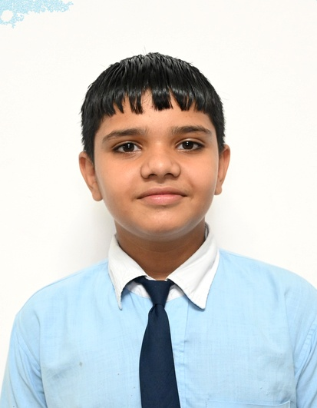
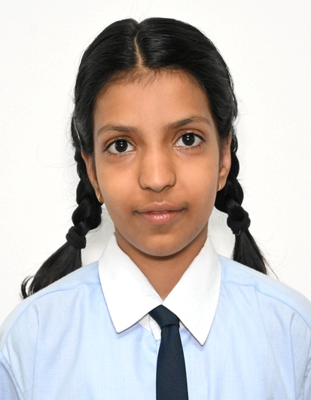
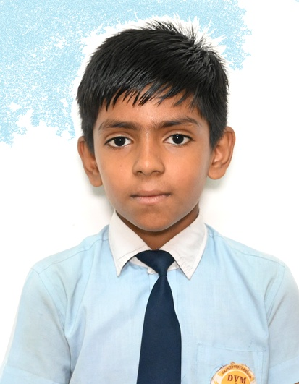
HOCKEY
CBSE WEST ZONE/SGFI
UNDER-14 GIRLS & BOYS (2025-26)
CONGRATULATIONS
MANSHI
KULHAR
PARIN
MANSHI
MAHLA
SHRITIMA
SHEKHAWAT
RAJ
SHEKHAWAT
SRISHTI
UJJWAL
SGFI DISTRICT GOLD MEDAL & BRONZE MEDAL
CBSE WEST ZONE
SILVER MEDAL

Slide 13
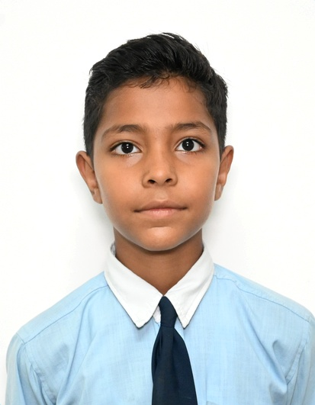
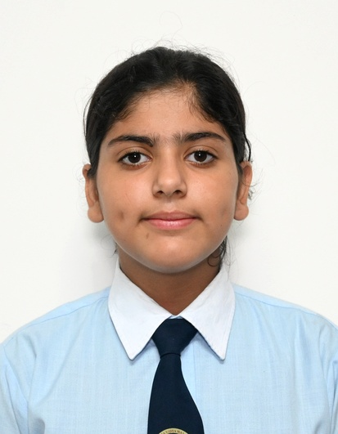
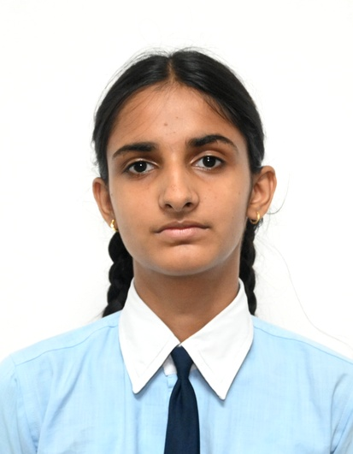
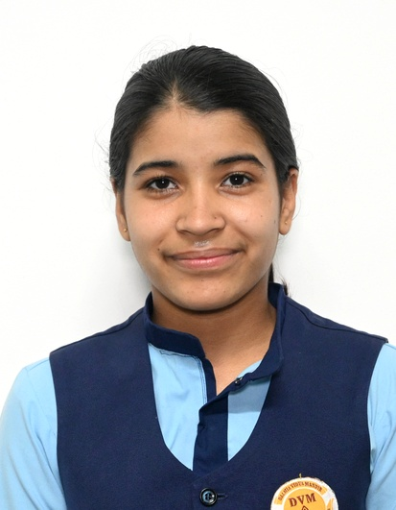
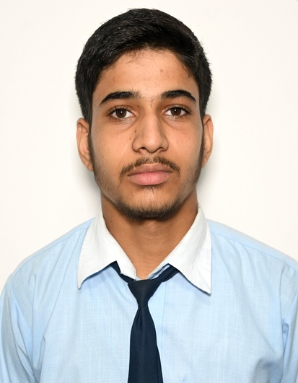
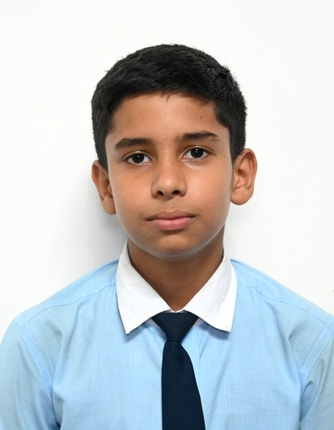
HOCKEY
CBSE WEST ZONE/SGFI
UNDER-14 & 17 GIRLS & BOYS (2025-26)
CONGRATULATIONS
JYANSH SHEKHAWAT
ANVI
RIYANSHI
PALAK
YASH
KALIRAWANA
LAKSHYA
BHASKAR
CBSE U-14 WEST ZONE SILVER MEDAL
SGFI DISTRICT U-17 SILVER MEDAL BRONZE MEDAL

Slide 14
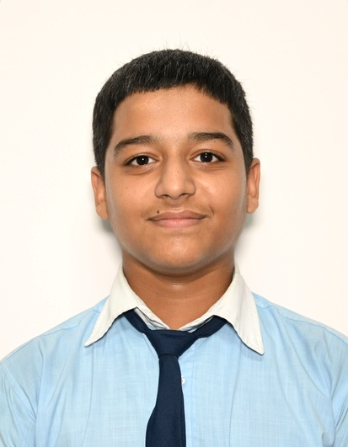
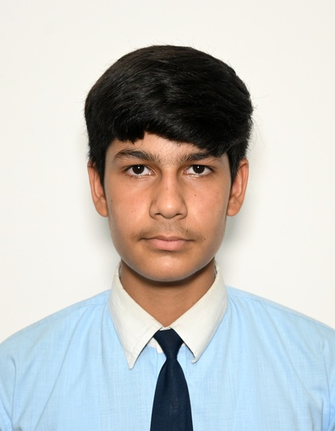
SHOOTING
SGFI STATE/SGFI NATIONAL
UNDER-17 BOYS (2025-26)
SGFI STATE GOLD MEDAL &
SGFI DISTRICT SILVER MEDAL
CBSE WEST ZONE BRONZE MEDAL & SGFI DISTRICT BRONZE MEDAL
CONGRATULATIONS
NATIONAL PLAYER
SACHIN PACHAR
DHANANJAY
BHARIA

Slide 15



THANK YOU

